Slide 1

Multicast Chatting Tool
Group Communication Using UDP Multicast
Name: [Mohammed Sakib Hasan]
ID: 2102052Reg. NO: 10179
Course: Computer Networking / Socket Programming Project

Slide 2

Project Description
This project introduces a robust, real-time multicast-based chat application, designed to facilitate seamless group communication across multiple processes. It enables users to engage in dynamic conversations, sending and receiving messages instantly within a shared multicast environment.
Send Messages
Receive Messages
Real-time Communication
Broadcast messages to all participants.
Get updates from every member in real-time.
Interact instantly via a dedicated multicast address.

Slide 3
Key Objectives
Our primary goals for this project focus on creating an efficient, user-friendly, and technically sound group messaging system.
Group Messaging
Unlimited Messages
Guaranteed Delivery
Implement a reliable group messaging system via multicast.
Allow each process to send any number of messages.
Ensure every message reaches all group members.
Simple Interface
Network Demonstration
Build a straightforward and intuitive user experience.
Showcase network-level group communication effectively.

Slide 4
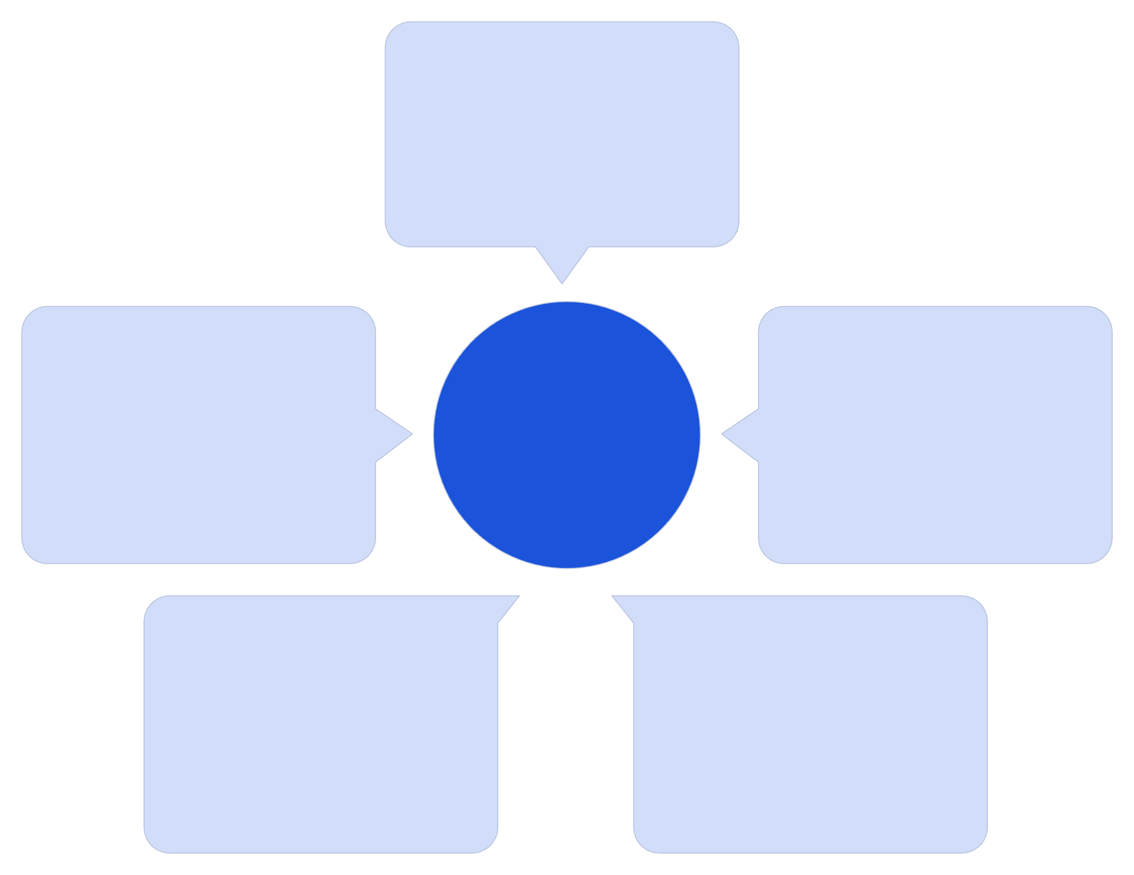
Understanding Multicast
Multicast is a highly efficient one-to-many communication method where a single transmission can be simultaneously received by multiple destinations.
Sender
Single data source
Receiver C
Multicast Distribution
Multicast Group
Group member device
Efficient distribution point
Receiver B
Receiver A
Group member device
Group member device
One-to-Many: A single source sends data to a specific group of recipients.
IP Range: Utilises a special range of IP addresses (224.0.0.0 – 239.255.255.255).
Efficiency: Only one copy of the data is sent from the source, reducing network load.
Applications: Commonly used in live streaming, video conferencing, online gaming, and chat systems.

Slide 5

System Architecture
The core of our chatting tool relies on a robust multicast communication flow, ensuring that messages are efficiently disseminated to all connected participants.
Recipient Devices
Chat App
User process sends message
All subscribed endpoints receive
Multicast Communication Flow
Multicast Group
UDP Socket
224.x.x.x address range
Encapsulates and forwards datagram
User Process
UDP Socket
Initiates message transmission.
Establishes connection to the multicast group address.
Multicast Group
Listening Processes
Facilitates simultaneous message delivery.
All receive the same message concurrently.

Slide 6
Implemented Features
Our Multicast Chatting Tool is equipped with a suite of features designed for a seamless and intuitive group communication experience.
Real-time Messaging
Self-Delivery
Instantaneous message sending and receiving.
Processes receive their own sent messages.
Multi-User Support
Shared Group Chat
Accommodates multiple simultaneous participants.
Centralised communication for all members.
Platform Independent
Clean UI
Ensures compatibility across various operating systems.
Web version with a WhatsApp-style interface for familiarity.

Slide 7
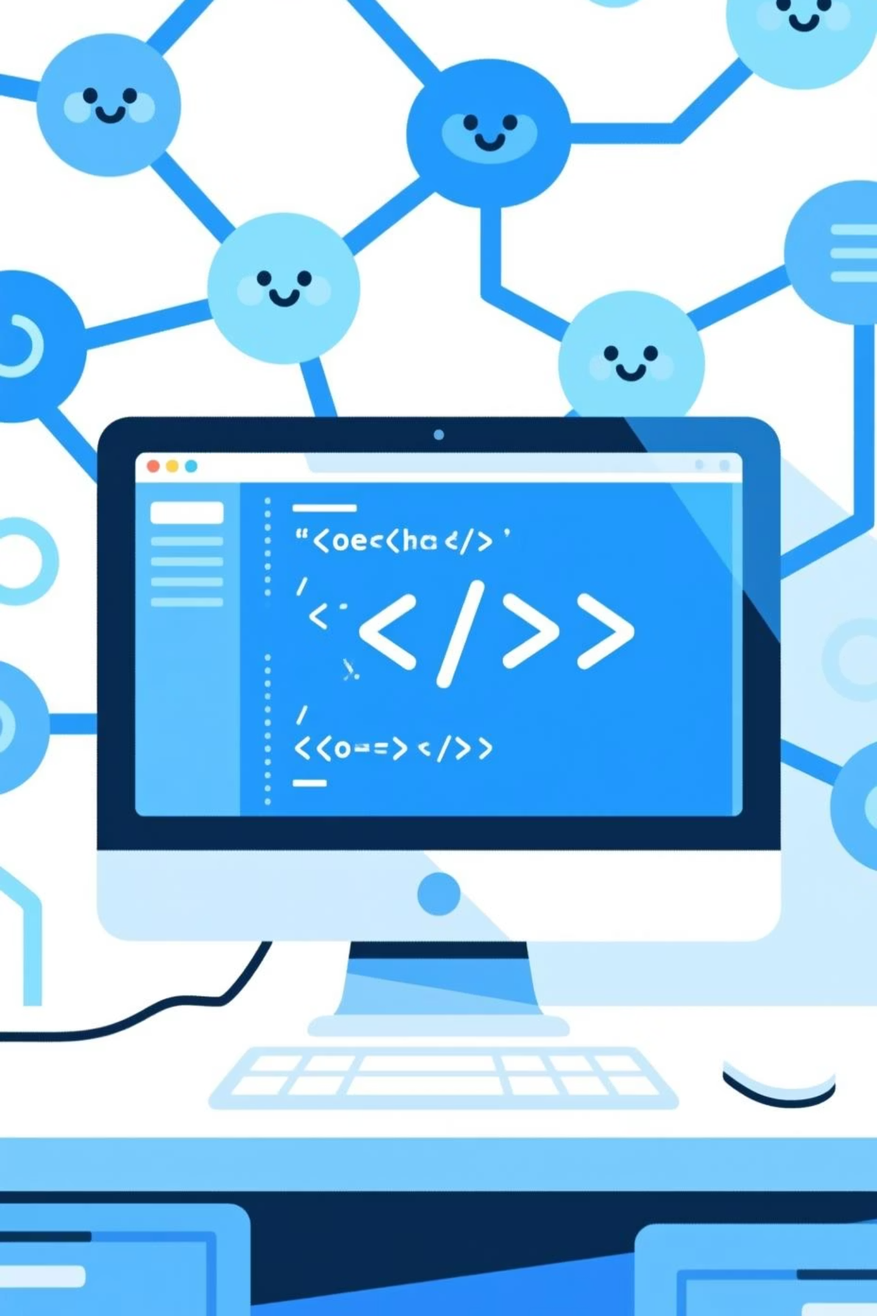
Technical Deep Dive
The backend of our Multicast Chatting Tool leverages Python for network operations and a modern web stack for the user interface, ensuring efficient and responsive communication.
Core Mechanics
Pseudocode Snippet
UDP Socket: Creation and configuration for multicast.
# Python Multicast Logicsock = socket.socket(...)sock.setsockopt(IPPROTO_IP, IP_ADD_MEMBERSHIP, ...)while True: data, addr = sock.recvfrom(1024) print(f"Received: {data.decode()} from {addr}")# Flask-SocketIO Integration@socketio.on('message')def handle_message(msg): send(msg, broadcast=True)
IP_ADD_MEMBERSHIP: Joining the designated multicast group.
Listening Loop: Constantly monitoring for incoming messages.
Sending Loop: Facilitating user message transmission.
Web Interface
Framework: Built with Flask for robust web serving.
Real-time: Utilises Socket.IO for instant updates.
Backend: Python-driven multicast implementation.

Slide 8
Operational Workflow
The user workflow is designed to be intuitive and efficient, ensuring messages are broadcast, received, and displayed in real-time across all participating devices.
01
02
03
User Enters Message
Message Sent to Multicast Group
Messages Received by All Processes
The user types their message into the chat interface.
The message is broadcast to the designated multicast address (e.g., 224.1.1.1:5007).
Every process listening on the multicast group instantly receives the message.
04
05
Receiver Displays Message
UI Updates Automatically
The message is immediately shown on the receiver's screen.
The user interface refreshes to display the new message in real-time.

Slide 9
Thank You!
We deeply appreciate your attention and active engagement throughout this presentation on the Multicast Chatting Tool. Your presence made it truly valuable.
Questions & Discussion
Connect With Us
We are now eager to answer any questions you may have and welcome your insights.
Email: ug2102052@cse.pstu.ac.bd

